Slide 1


Prepare for when Disaster Strikes
Steve Jones
Editor, SQLServerCentral

Slide 2
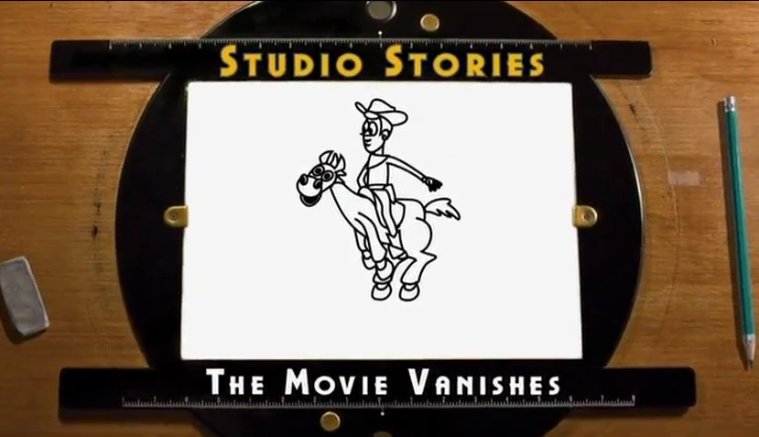
From: http://www.youtube.com/watch?v=EL_g0tyaIeE
Notes:
In 1999, Pizar was working on their 3rd movie, Toy Story 2. This was the sequel to the smash Toy Story and a follow-up to the award winning “A Bug’s Life”. This was a $90mm film, the most expensive film they had made to date.
Two of the people involved in the project made a short video that talks about a disaster they had.

Slide 3
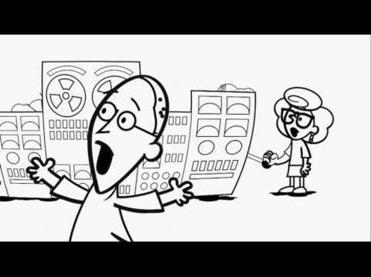
Notes:
At some point late in production, someone ran an “RM *” on their Linux or Unix machines. This starts deleting all the files and folders. Quickly. It’s the DOS equivalent of “RMDIR *.* /s /q”. It’s a quick delete, and as expected,

Slide 4
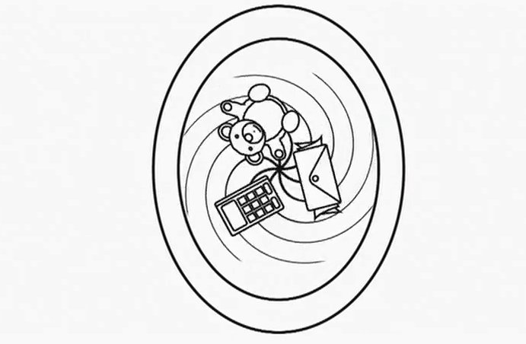
Notes:
It’s a flush of the file system. In about 20 sec, the systems were empty. Note that this isn’t a hurricane. This isn’t a major event that affected people, buildings, etc. This was a user error, and one that occurred as a semi-mature company. This was their third major animation film, but they had been in business for 20 years.

Slide 5
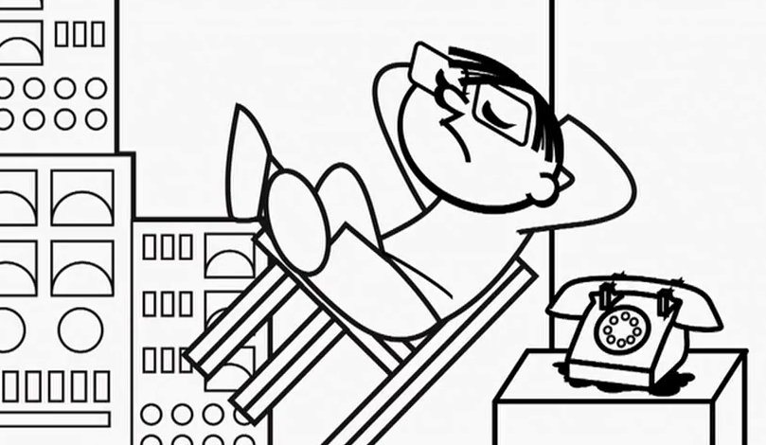
Notes:
What did they do? They called IT. The phone rang. I hate it when my phone rings. One of my goals as a production operator has been to ensure my phone doesn’t ring. If my phone rings, it usually means something is bad, or at least something it wrong. When I answer it

Slide 6
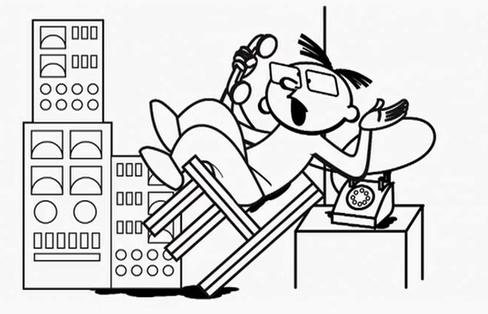
Notes:
There’s often someone yelling. In this case, critical parts of the film were gone. This was enough of a problem that they estimated that 20-30 people working for a year couldn’t recreate the lost work. The backups were bad, and they were stressed. If you’re curious about what they did, watch the film. It’s cute, and funny, and my kids enjoyed it.

Slide 7
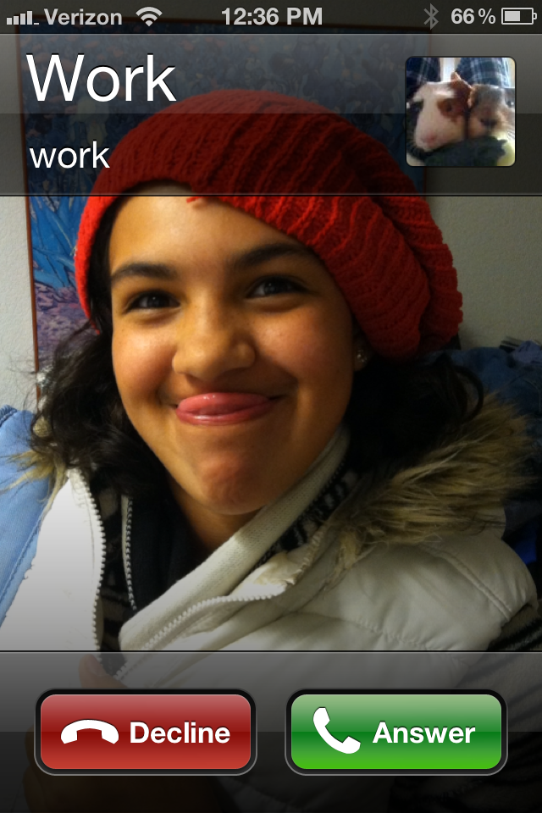
Notes:
That was a disaster. Not one reported on the news, probably not one known outside of the company, but a disaster. It was unforeseen, and their response was not what I’d want to happen in any of my jobs. When your phone rings, and it’s a disaster of any sort, at any scale, to any of your systems…

Slide 8
WWYD?

Slide 9
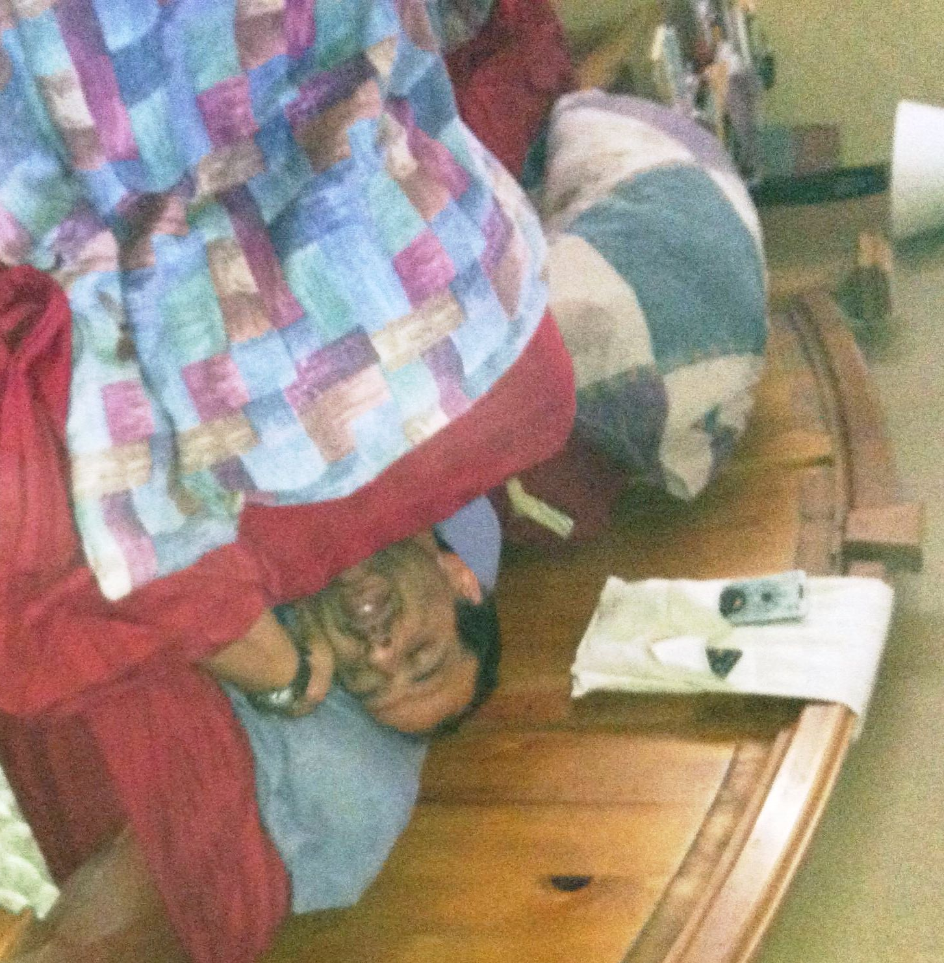
Notes:
Imagine that it’s 2am. You’re asleep, but not on call. You are resting peacefully, dreaming about something wonderful. Riding a horse through fields of sunflowers, or defending the universe from space aliens, take your pick.

Slide 10
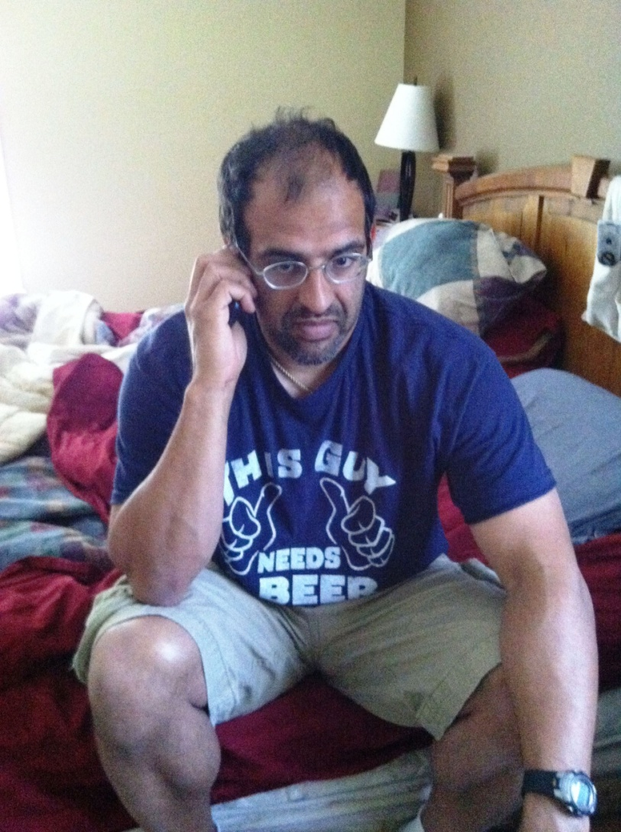
Notes:
Your phone rings. It’s work and they tell you there’s a hardware problem.

Slide 11
Hard drive smash
Notes:
It doesn’t matter if it’s a failed hard drive

Slide 12
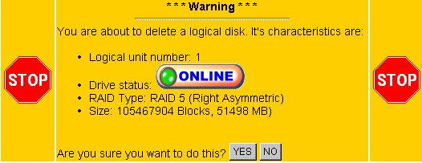
Notes:
It doesn’t matter if it’s a LUN that’s been deleted and reassigned

Slide 13
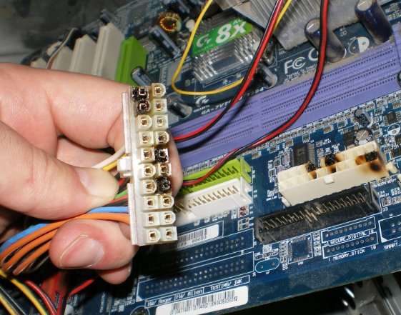
Notes:
It doesn’t matter if it’s a blown power supply

Slide 14
WWYD
Notes:
What do you do?

Slide 15
Get the system running
Notes:
Obviously you need to get the system running

Slide 16
ASAP

Slide 17
SLA
RTO/RPO
Notes:
That means meeting your SLA, your RPO RTO. But what are they, and can you meet them?

Slide 18
SLA
RTO/RPO
Notes:
That means meeting your SLA, your RPO RTO. But what are they, and can you meet them?

Slide 19
Alert time
----------------------------
RTO
Notes:
Let’s look back at the ways in which you might respond quicker, and perhaps more accurately. The RTO is essentially the time it takes to get your system back running after a disaster. It consists of the alert time, which is the time from when the disaster occurs until some alert is raised. This could be automated, or a trouble ticket being filed by a user.

Slide 20
Alert time
+ Response time
----------------------------
RTO
Notes:
We then add in response time. This is the time it takes for an expert of some sort to respond. This could be someone picking up a ticket, getting a phone call, or some other communication. Once they get the note there is an issue, there’s the time to actually log onto the system.

Slide 21
Alert time
+ Response time
+ Assessment time
----------------------------
RTO
Notes:
Assessment time is the time to actually figure out what’s wrong.

Slide 22
Alert time
+ Response time
+ Assessment time
+ Decision time
----------------------------
RTO
Notes:
Decision time is the time to actually decide what to do. Expert IT people can often make a decision in minutes. Bring in a group of managers to help them and the decision could take hours.

Slide 23
Alert time
+ Response time
+ Assessment time
+ Decision time
+ Action time
----------------------------
RTO
Notes:
Action time is the time to implement the fix. This could be replace the hardware, it could be the time to restore the database, it could be the time to plug the server back in and reboot it because the cleaning person hit the cord with a vacuum.

Slide 24
Alert time
+ Response time
+ Assessment time
+ Decision time
+ Action time
+ Validation Time
----------------------------
RTO
Notes:
Once the system is running, if you turn it over to users without validating it, you’re not acting professionally. You’re being lazy, and you’re assuming things work. Does everyone know what happens when you assume things? All of this together is the time to actually get your system running. These various items can be measured in significant amounts of time.

Slide 25
Alert time
+ Response time
+ Assessment time
+ Decision time
+ Action time
+ Validation Time
----------------------------
RTO
ms – days
minutes – hours
minutes – hours
minutes – hours
minutes – days
minutes - hours
Notes:
Once the system is running, if you turn it over to users without validating it, you’re not acting professionally. You’re being lazy, and you’re assuming things work. Does everyone know what happens when you assume things? All of this together is the time to actually get your system running. These various items can be measured in significant amounts of time.

Slide 26
Hardware Failure
Immediately
Replace Hardware
Restore System
Test System
Allow User Access

Slide 27
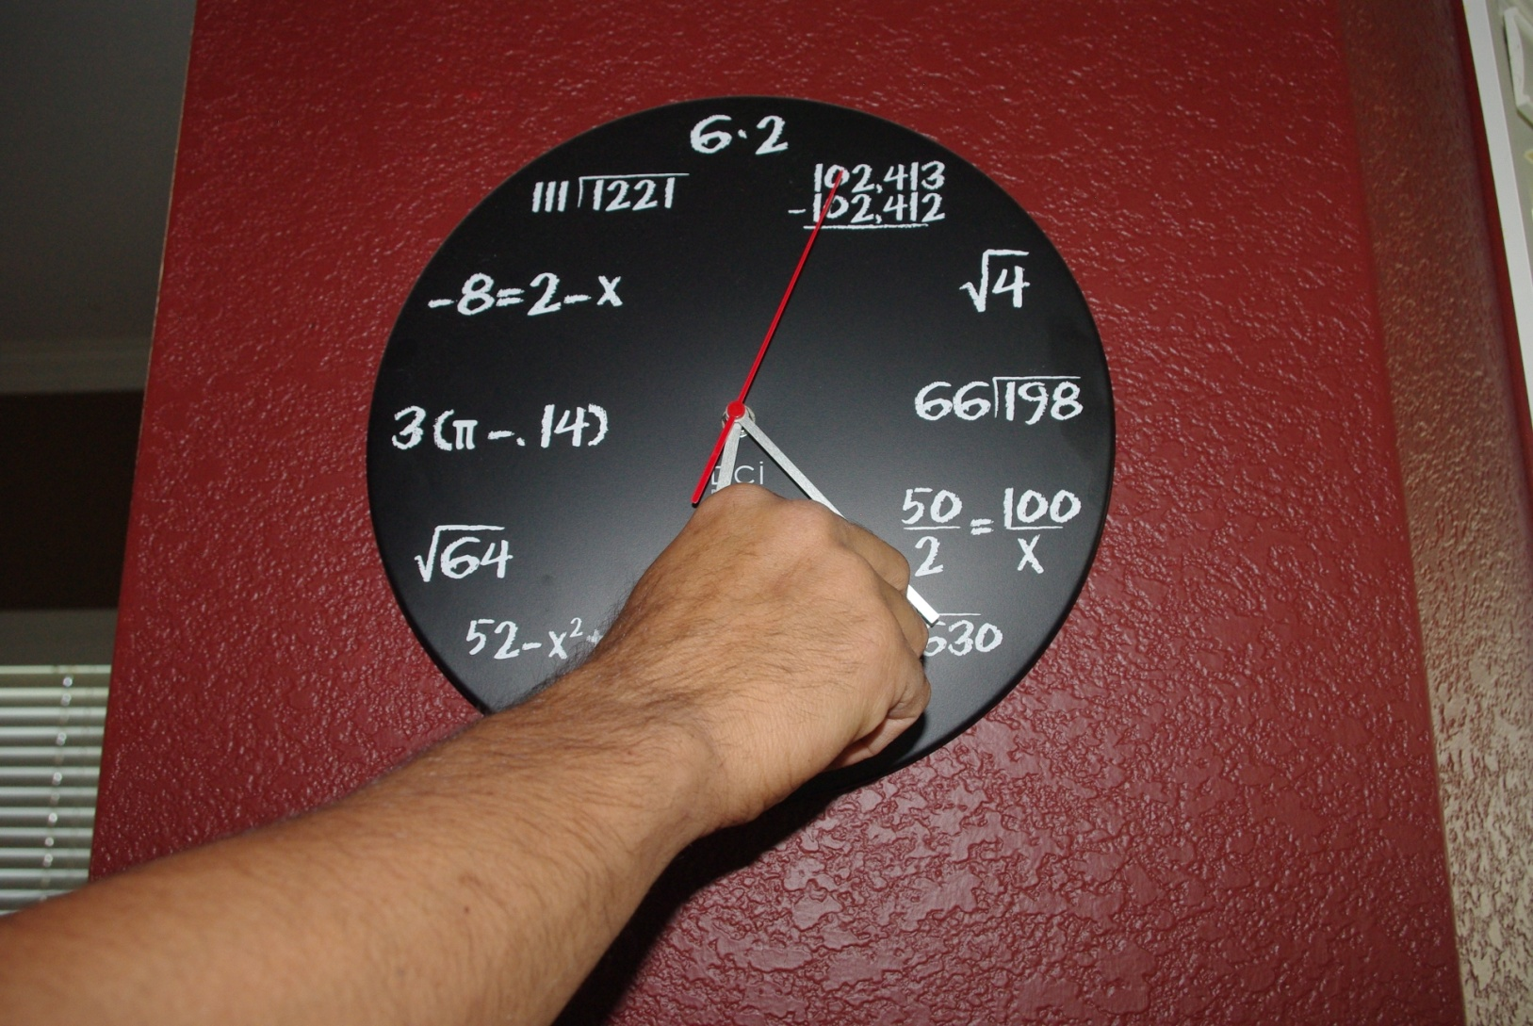
Notes:
But what if you could turn back the clock? Could you increase your chance of responding to this disaster? First let’s look at time.

Slide 28
Alert Time
The best defense is a good offense

Slide 29
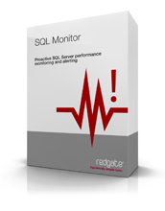
Alert Time
The best defense is a good offense
Reduce this with monitoring
Alerts
PBM
Auditing
Third Party Tools
Notes:
The best way to be alerted of things is with monitoring of your server.

Slide 30
Response time
Isn’t this minutes?

Slide 31
In grocer
Notes:
Even when you are on call, think about the places you can be. You could be at a kid’s sport event, in the shower, cutting the grass, or in the grocery store.

Slide 32
Walk out of store
Notes:
You get the call, and you have to leave.

Slide 33
Get in car
Notes:
Find your car, which will not be in the closest parking spot.

Slide 34
Drive home
Notes:
Get home

Slide 35
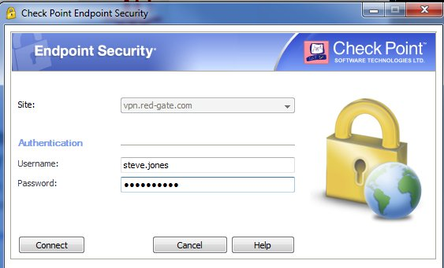
Notes:
Log into your VPN. You do use VPN, right?

Slide 36
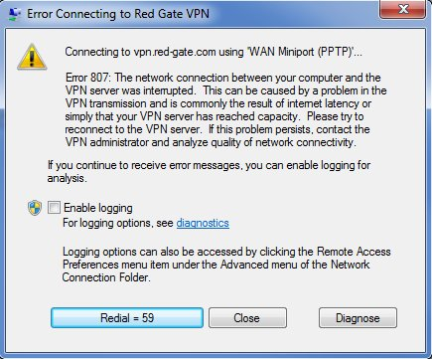
Notes:
Hope your connection works and then start working.

Slide 37
Response time is longer than you think.
Notes:
Response time is longer than you think. Plan for things to take some time. Plan for problems. Set the expectations early that response time will not be seconds unless you are at your computer.

Slide 38
Reducing Response Time
Pre-configured mobile device
Shared laptop or on-call VM
Tablet, phone, or other device with VPN or monitoring software
Remote connectivity
Aircard
Test this in advance.
Rules

Slide 39
Assessment Time
On your own
Training
Experience
Debrief others
Have a blog of disasters and fixes.
Run book is written by the most experienced people, checked by the least experienced people.*
* Think about using other IT workers

Slide 40
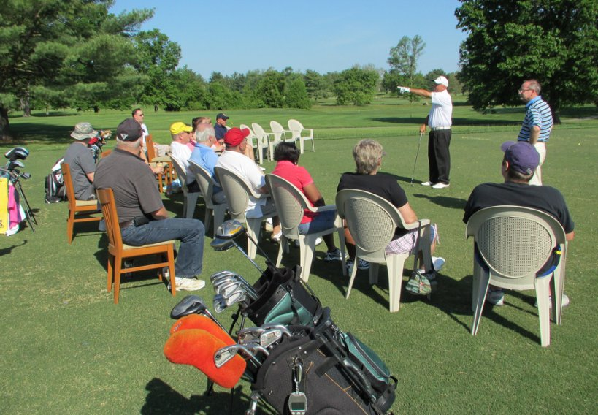
Decision Time
Notes:
You don’t want a group of managers making the decisions about what to do

Slide 41

Decision Time
Notes:
You also don’t want to be alone on an island making a decision

Slide 42
Decision Time
Make sure you understand the situation
Or ask for help
List 3 options
Don’t forget the implications
Pick the best one
Or present to a small group for a decision

Slide 43
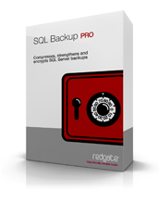
Action Time
Replace the hardware
Have spares parts
Have depot phone, account, logins
Restores
Practice different methods of recovering the system

Slide 44
Whoops
About to go to lunch
Need delete the test data for a load
Forget the Where clause
In production.

Slide 45
Whoops
Immediately
Call your boss
Restore?

Slide 46
Whoops

Slide 47
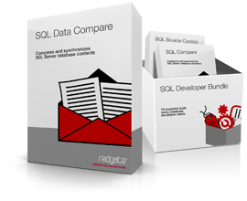
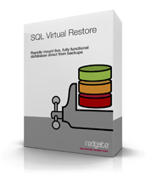
Rewind
Audited ETL processes
Log Readers
Virtual Restores

Slide 48
Corruption
Monday morning
The client says that their query won’t return.
You run a query on the table and get back a. 824 error.
Corruption was detected.
It’s in all backups for 2 weeks.

Slide 49
Corruption
Immediate Action
Call your vendor
Check backups
Restore on other hardware

Slide 50
Corruption

Slide 51
Corruption
Run DBCC
As often and on as many systems as possible.
Keep firmware, drivers up to date
Watch for issues reported by vendors or others.

Slide 52
Deployment
Friday night, date night
On call and you get notified that the deployment did not proceed as planned.
How do you rollback?

Slide 53
Bad Deployment
Immediate Action
Restore?
Undo?

Slide 54
Bad Deployment

Slide 55

Bad Deployment
Rewind
Database Snapshots - Enterprise Edition only
Rollback scripts
Comparison with VCS

Slide 56
Bad deployment
Whoops - delete all customers
corruption
Hardware crash

Slide 57
Bad deployment
Whoops - delete all customers
corruption
Hardware crash

Slide 58
Thanks
Questions
Please fill out your evaluations
www.sqlservercentral.com/forums
www.voiceofthedba.com

Slide 59
References
Backups, What are they good for? - http://www.simple-talk.com/sql/backup-and-recovery/backups,-what-are-they-good-for/
The Movie Vanishes - http://www.youtube.com/watch?v=EL_g0tyaIeE
Oren Jacobs (Pixar) answers a few questions - http://www.quora.com/Pixar-Animation-Studios/Did-Pixar-accidentally-delete-Toy-Story-2-during-production/answer/Oren-Jacob

Slide 60
Images
Toy Story Captures from: http://www.youtube.com/watch?v=EL_g0tyaIeE
Managers - http://www.flickr.com/photos/usagapg/7203570300/
Island - http://www.flickr.com/photos/torley/3454806000/
Burned PSU / connectors - http://www.flickr.com/photos/gamp/1983844631/
Remove Disk - http://techpubs.sgi.com/library/tpl/cgi-bin/getdoc.cgi?coll=linux&db=bks&fname=/SGI_EndUser/TPM_UG/ch03.html
Hard Drive - http://www.flickr.com/photos/jon_a_ross/1482849745/

